Slide 1

Jupyter notebooks and their widgets
Jean Bilheux
Neutron Imaging Computer Instrument Scientist
Materials Engineering Group
Neutron Scattering Division
ASM - 2023
Development

Slide 2
Table of Contents
Neutron imaging technique
Jupyter notebooks
Hands on using simple jupyter notebooks
Make a Jupyter notebook interactive
More advanced notebooks with widgets
Standalone interface
https://github.com/neutrons/asm_2023/tree/main/jean
Notes:
Here is how we gonna spent the next 45 minutes.
I will start by showing you what I have been doing before joining the imaging team.
Then in the first part I will describe my work as an imaging software developer
In the second part, I will talk about my work as Embedded imaging software developer and you will see how much the *embedded* word is important.
Finally I will give my vision of the CIS position

Slide 3
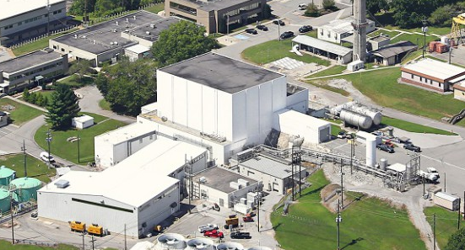

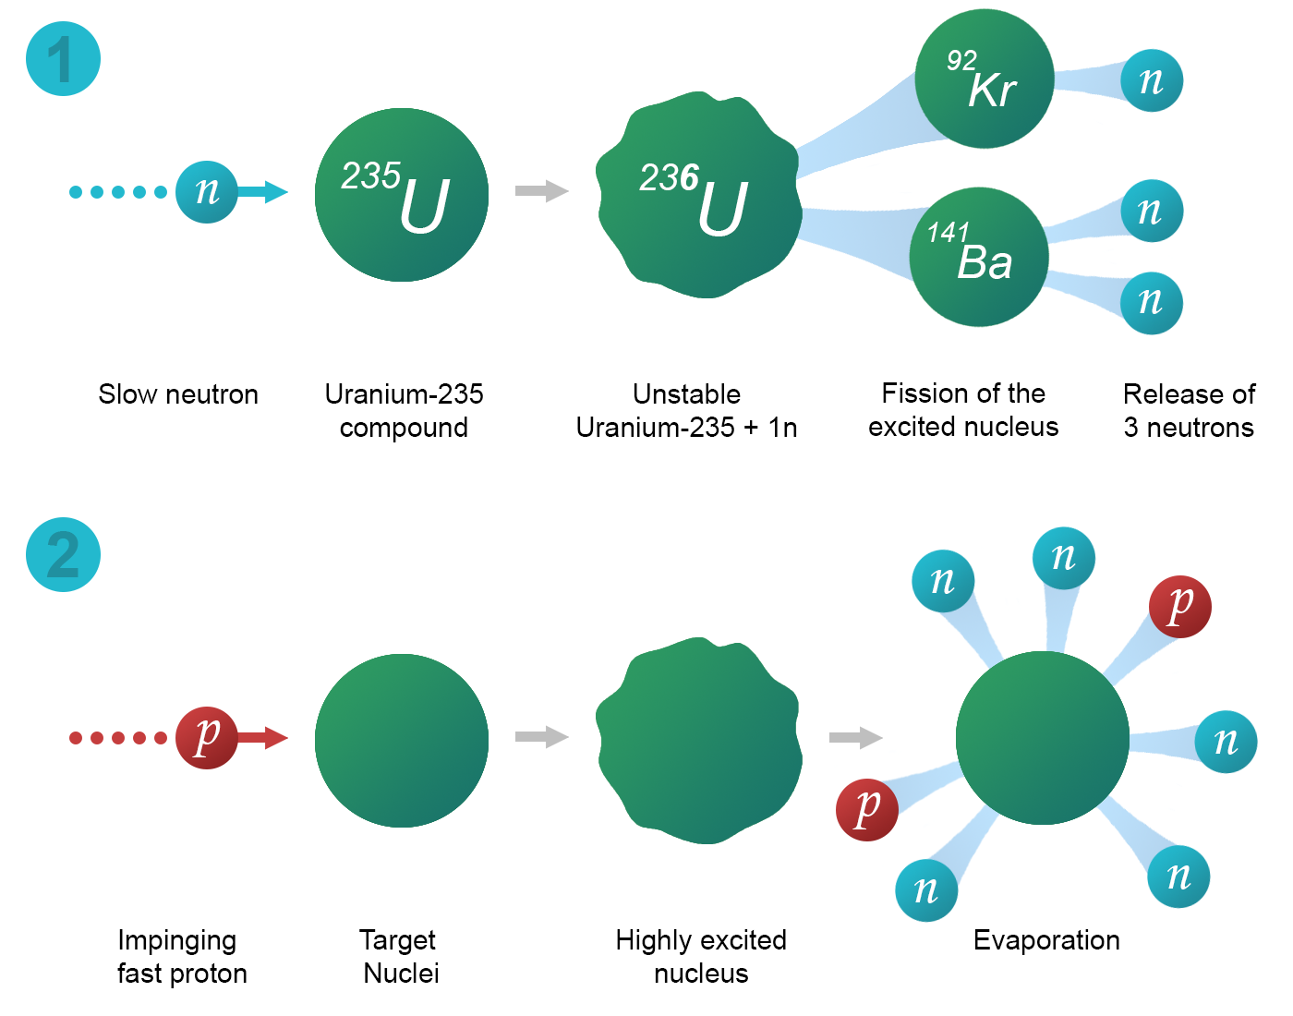
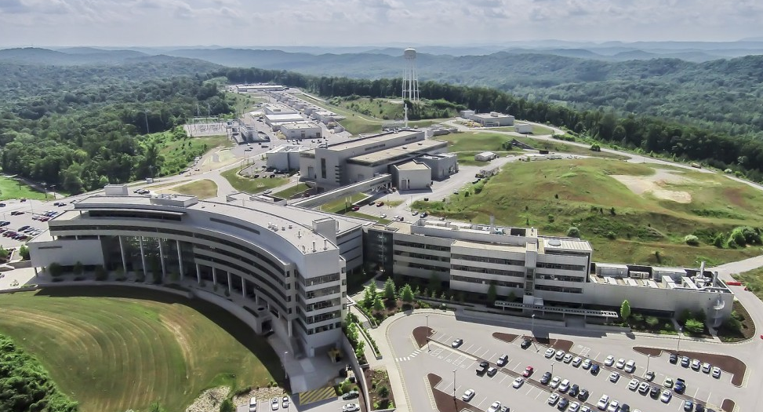
Neutron Imaging Technique
Fission (Continuous)
Spallation (Pulsed)
https://pan-learning.org/wiki/index.php/Introduction_to_neutron_scattering

Slide 4
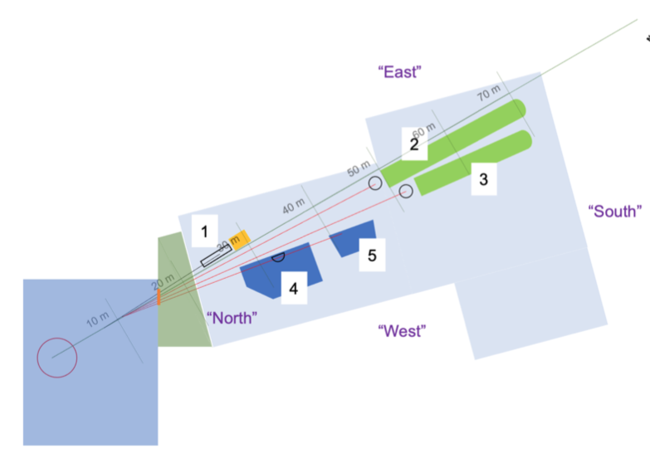
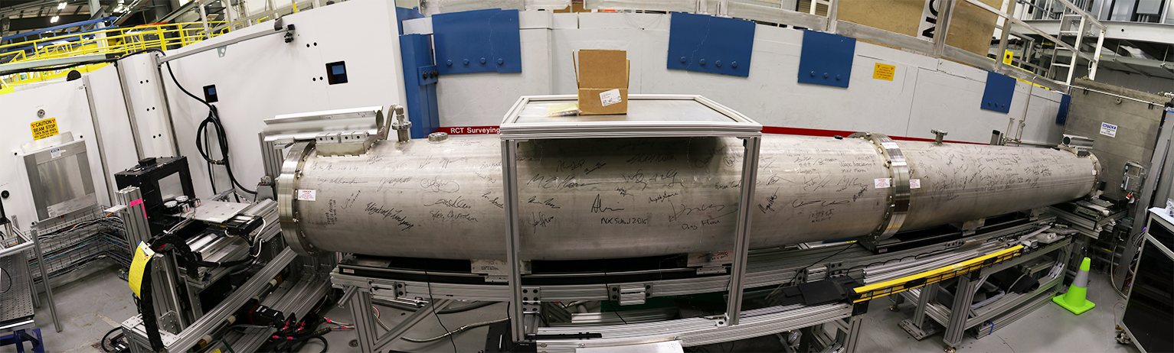
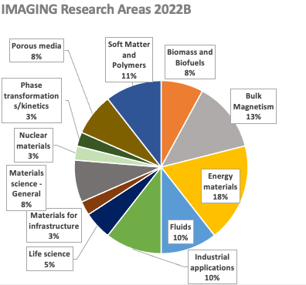
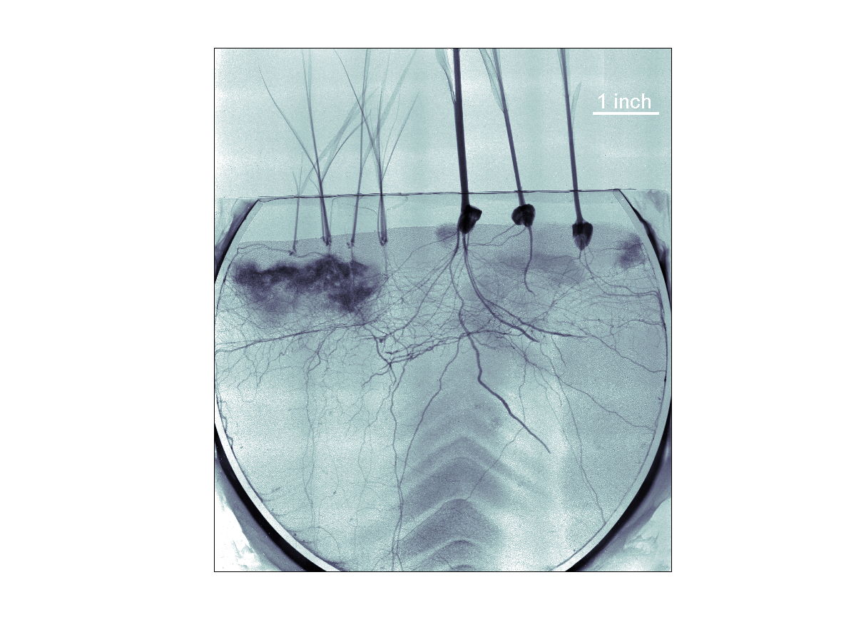
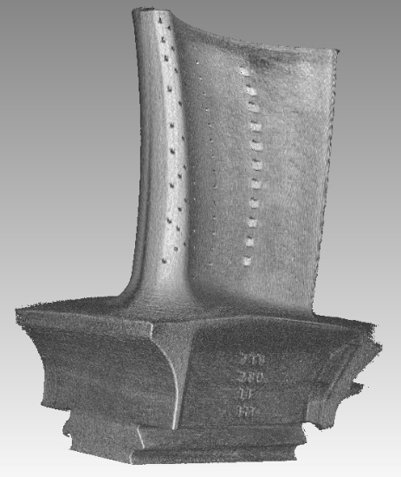
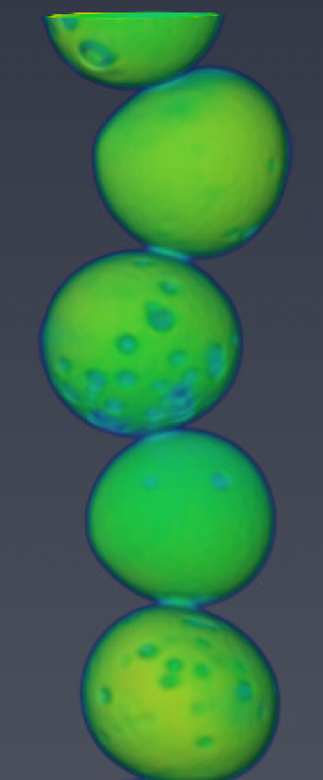
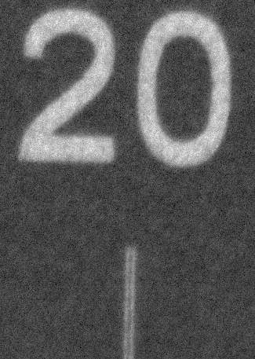
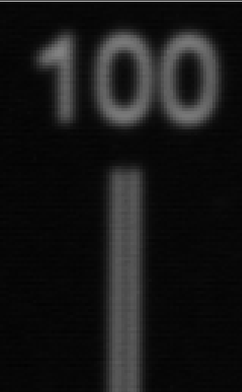
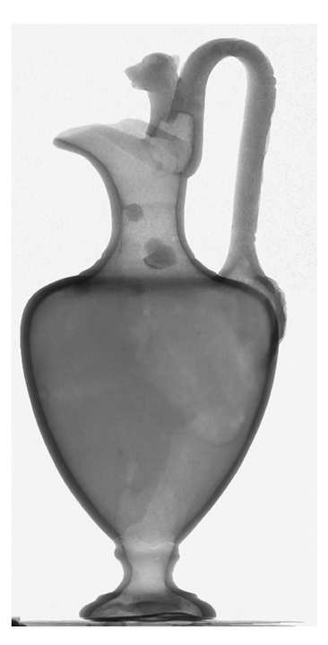
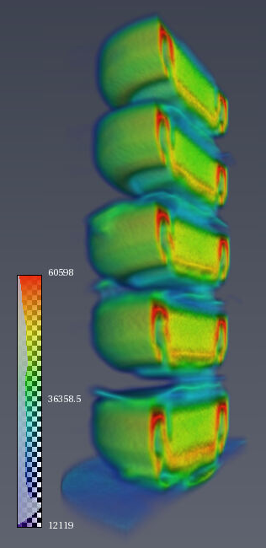
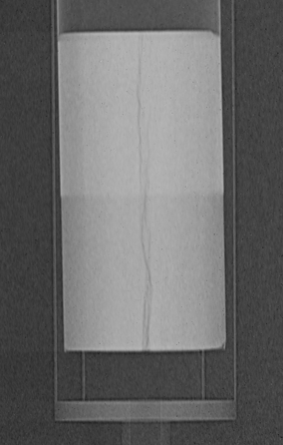

MARS
IMAGING (CG-1D)
Beam stop
Detector (CCD)
Neutron beam
Flight tube (He filled)
HFIR Cold Guide Hall
Rotation stage
Sample table
(HFIR layout figures are courtesy of Georg Ehlers )
Gap between lines = 20 μm
Gap between lines = 100 μm
Attenuation counts

Slide 5
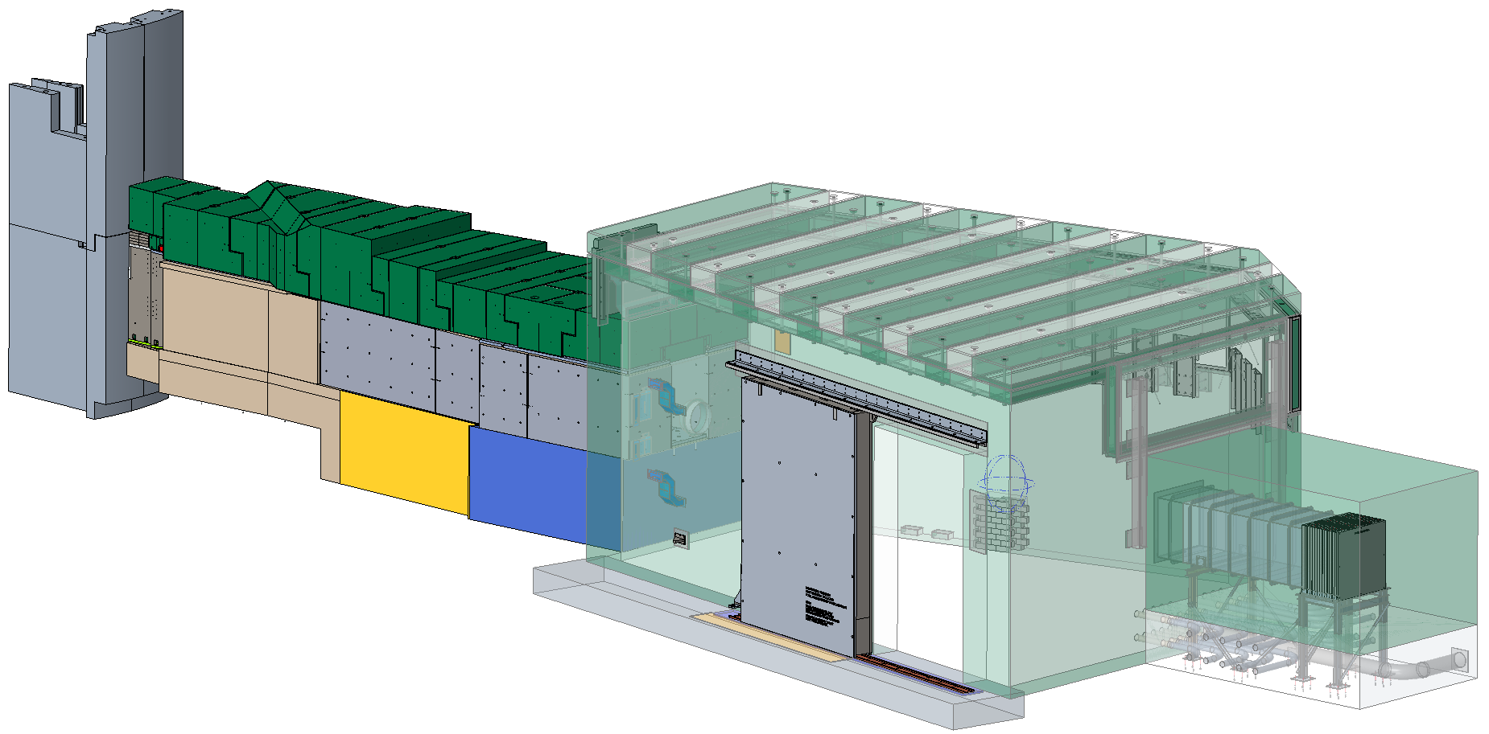
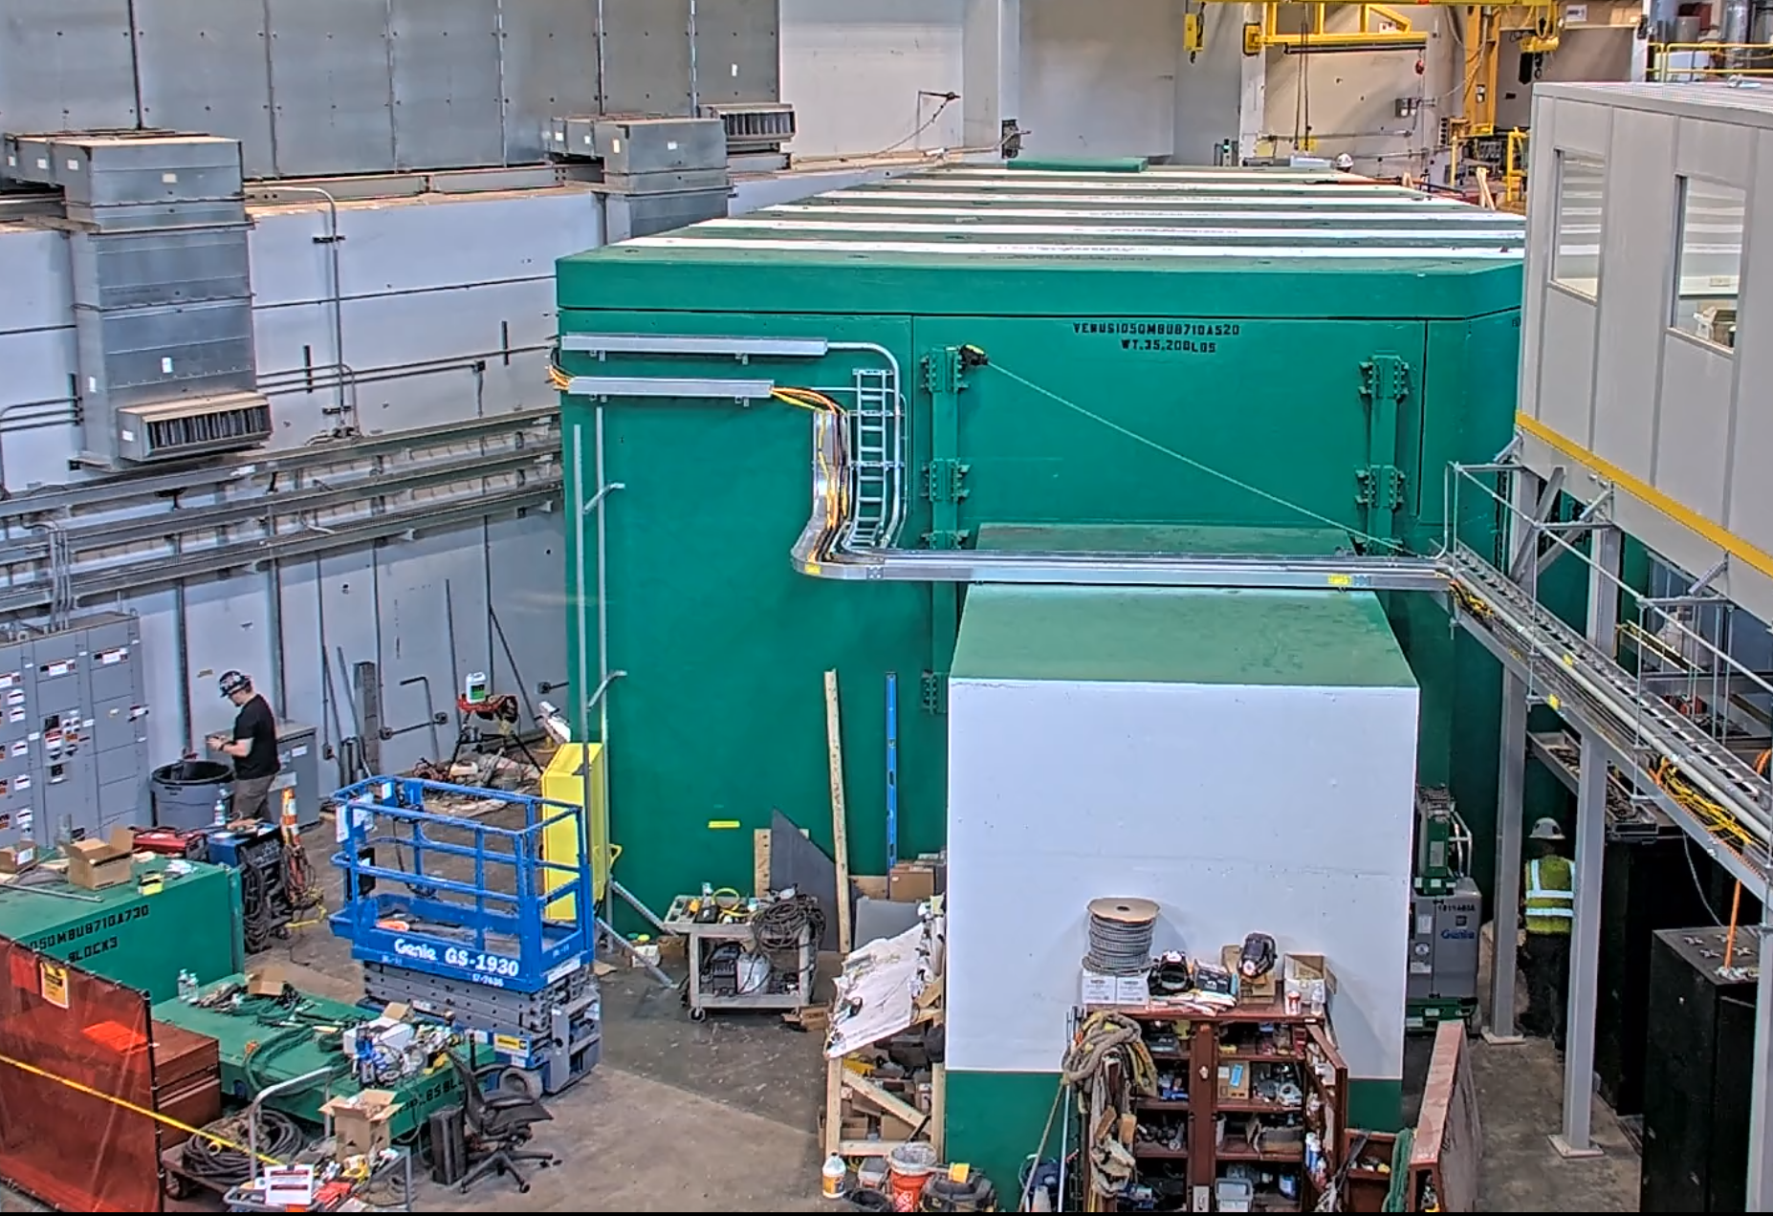
VENUS
Science areas: energy materials such as electrochemistry in battery cells, materials science including additively manufactured alloys and superalloys behavior under stress (heat, pressure), nuclear materials, archaeometry, etc.
A wavelength dependent imaging beamline with a detector position at 25m with a maximum field-of-view of 20 x 20 cm² and a spatial resolution of ~ 100 μm
Optimized for unique imaging capabilities:
Bragg-edge imaging – quantitative interpretation of total cross-section provides crystalline structure characterization (cold neutrons ~ meV, 10 μs time resolution)
Resonance imaging – isotopic-sensitive spatially-resolved spectroscopy technique (epithermal neutrons ~ eV, 100 ns time resolution)
VENUS Completion Date: Summer 2024
Schematic (top) and photograph (left) of VENUS

Slide 6
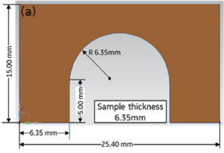
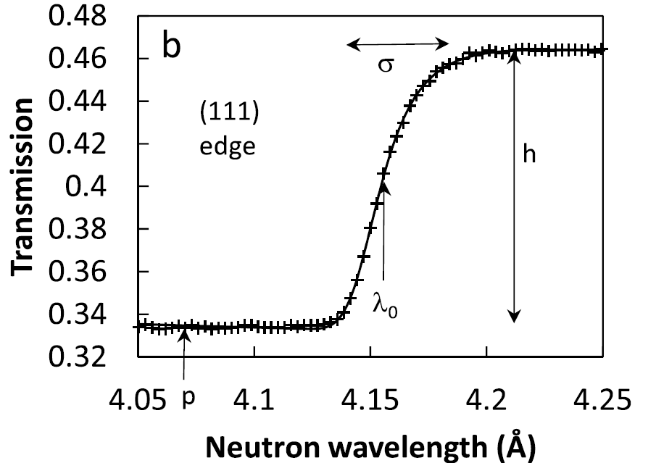
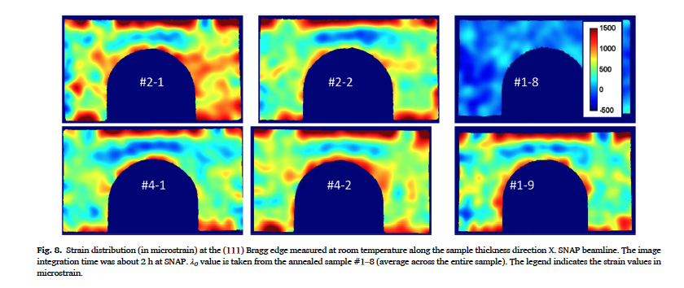
Bragg edge imaging
VENUS
Resonance imaging
Material Behavior: Monitoring residual strain relaxation and preferred grain orientation of additively manufactured Inconel 625 by in-situ neutron imaging
Material Elemental/Isotopic Content: 3D maps of elemental/isotopic distribution in objects.
Microstrain
A.S. Tremsin et al, Additive Manufacturing 46 (2021) 102130.
Zhang Y., Transactions of the American Nuclear Society, (2018).

Slide 7
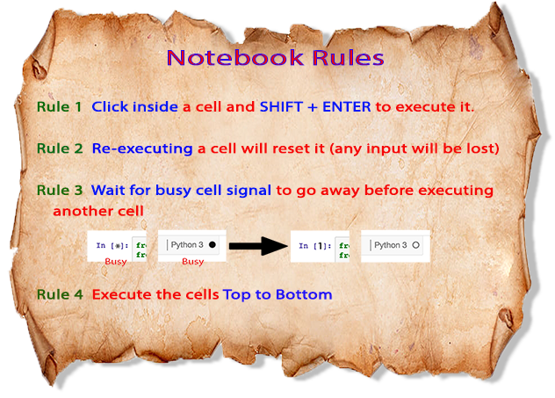
Jupyter notebooks
Notes:
Presentation of what they are, how to get them, and to run them

Slide 8
Hand-on – cropping a stack of images
PLAN
Load the images
Visualize
Select region to crop
Visualize result
Export new images
jean/exercises/1.notebook_without_widgets_example1.ipynb

Slide 9
Hand-on – cropping a stack of images
PLAN
Load the images
Visualize
Select region to crop
Visualize result
Export new images
jean/exercises/1.notebook_without_widgets_example2.ipynb

Slide 10
Hand-on – cropping a stack of images
PLAN
Load the images
Visualize
Select region to crop
Visualize result
Export new images
User Input Errors
Location of data (typos, not familiar with file path string …)
Extension of input files (not .tiff, but .tif)
Number of files to visualize
Output folder (forget to change to example2 -> overwriting example1 folder)
jean/exercises/1.notebook_without_widgets_example2.ipynb

Slide 11
Hand-on – cropping a stack of images
NEW PLAN using widgets
Load the images
Visualize
Select region to crop
Visualize result
Export new images

Slide 12
More advanced used of widgets
Topaz config file
Create a config file, later used by a script
Timepix3
Fitting Bragg peaks
HDF5 MCP /SNS/SNAP/IPTS-30008/nexus/run58682_histo.h5
time_shift=11876 / offset=1863 / Ta
Range =[1.445, 2.474], Edge=[1.919, 2.143]
Registration
IPTS-1992/shared/processed_data/02/normalized
iBeatles
/SNS/VENUS/shared/SNAP_calibration_Ni_Powder

Slide 13
Infos
Neutron imaging web site (https://neutronimaging.ornl.gov/)
All notebooks tutorials
Many “how to…” guides
List of ipywidgets (https://ipywidgets.readthedocs.io/en/latest/examples/Widget%20List.html)
My blog with many python tricks I found out over the years (https://jeanbilheux.wordpress.com/)
Useful python librairies
pyqtgraph
matplotlib
numpy
pandas
scikit-image
piillow
ipywe

